Slide 1
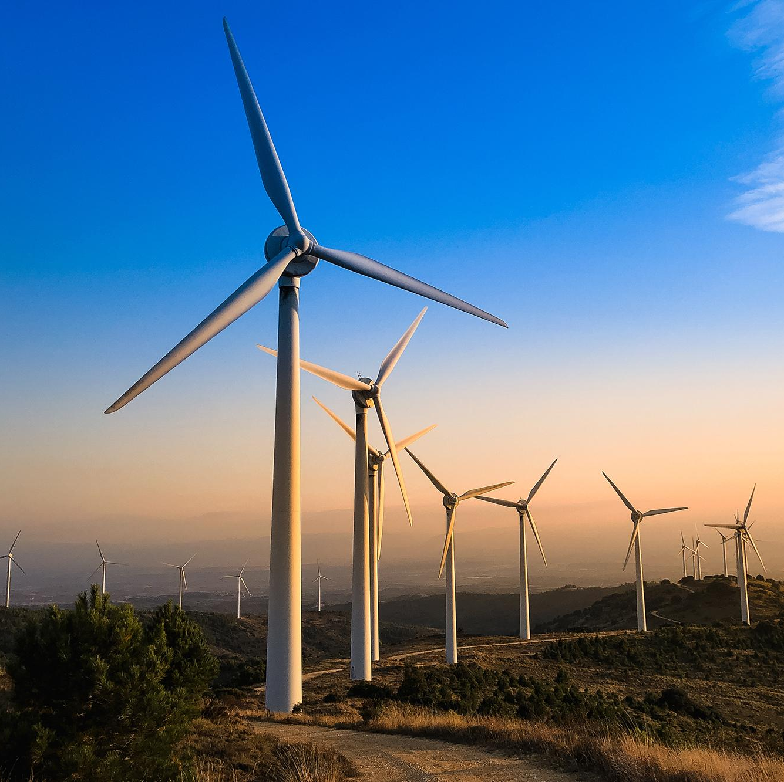
HARNESSING THE POWER OF KENYA'S WIND: INSIGHTS FOR WIND FARM OPTIMIZATION

Slide 2
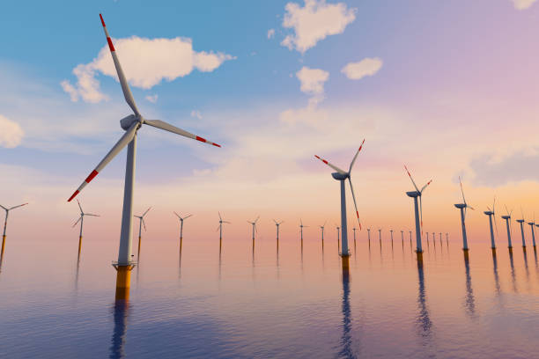
MEET OUR MEMBERS:
ROBINSON MUMO
ABDIDEQ ADAN
PRUDENCE COREDO
HERI KIMOTHO
GICHOGU MACHARIA

Slide 3

PROJECT OVERVIEW
Our project is a critical initiative designed to address Kenya's persistent blackout issues caused by grid overload.
We aim to analyze and use historical weather data (wind) to determine optimal locations in Kenya to establish wind farms

Slide 4
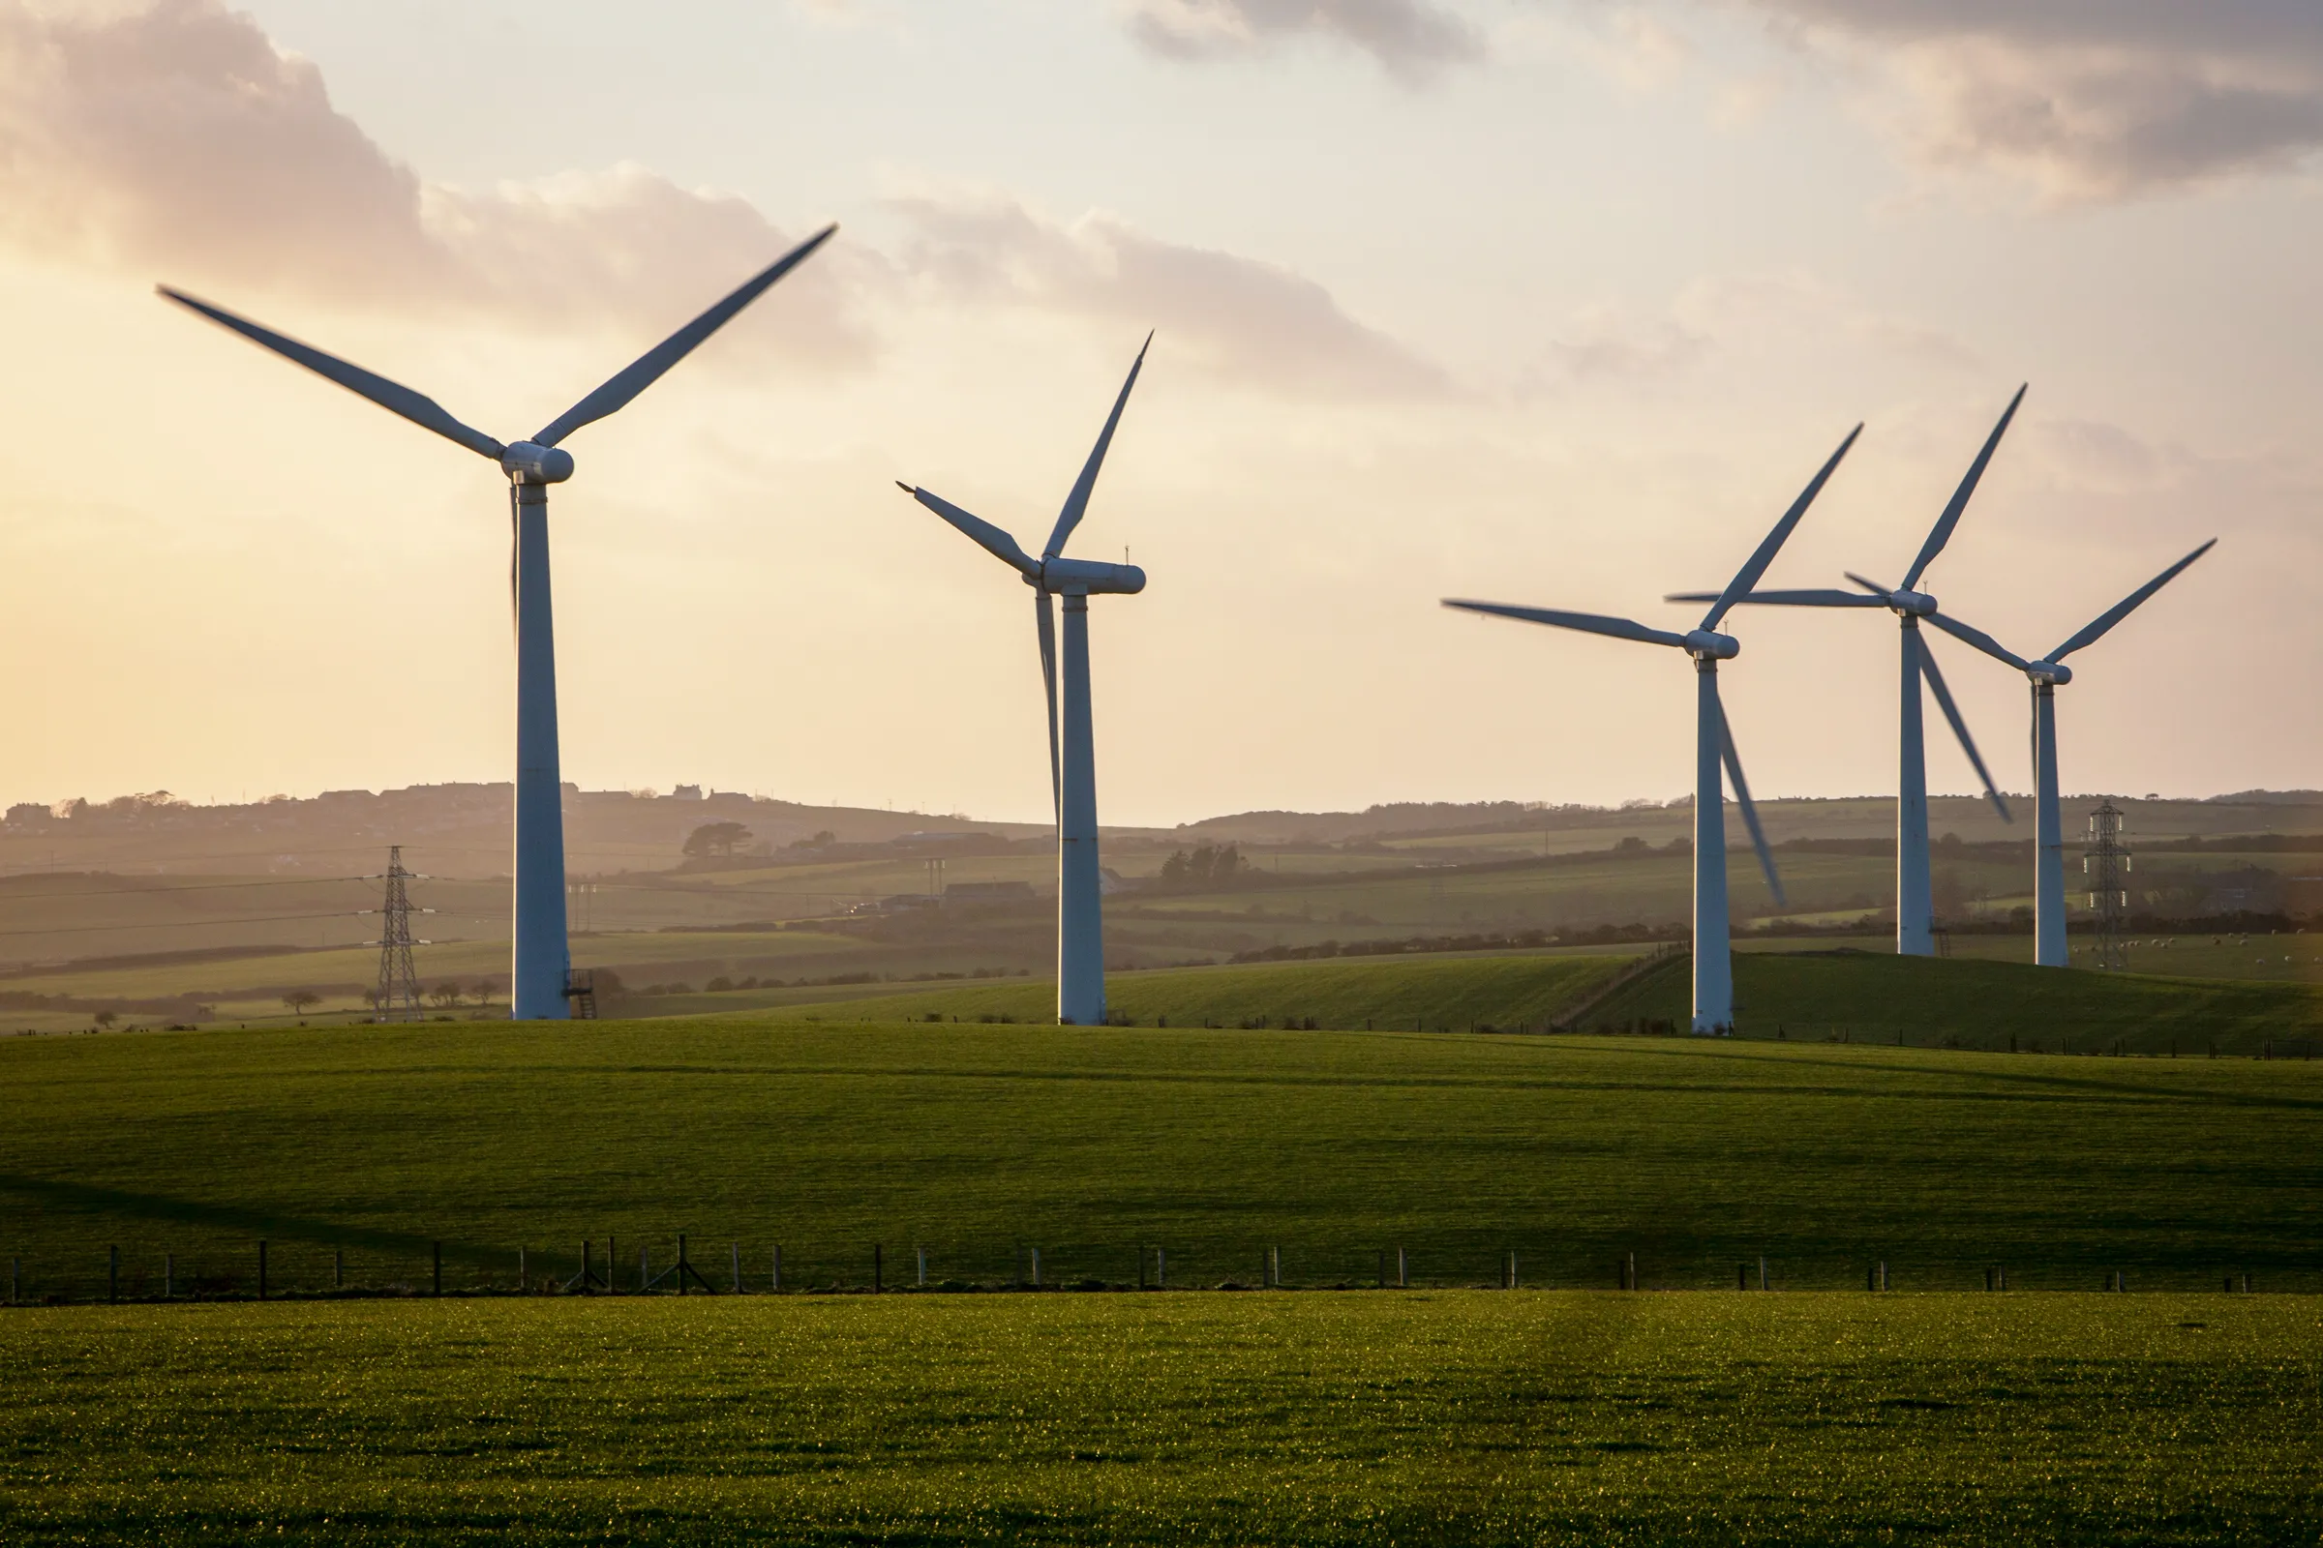
BUSINESS UNDERSTANDING
Target Stakeholders:
Government Agencies:
Energy Ministry.
Investors and Financiers:
Private Investors.
Despite its high potential for wind energy generation, wind power in Kenya currently contributes only about 16 percent of the country's total electrical power.
By tapping into Kenya's abundant wind resources more effectively, there is immense potential to increase the contribution of wind power to the nation's energy mix.

Slide 5
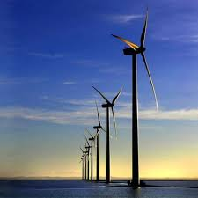
PROBLEM STATEMENT
The goal is to provide actionable information to inform players in the energy production industry of places it can supplement our energy needs through harnessing wind energy.
Kenya's electricity grid is frequently overloaded, leading to widespread blackouts that adversely affect businesses and households.

Slide 6
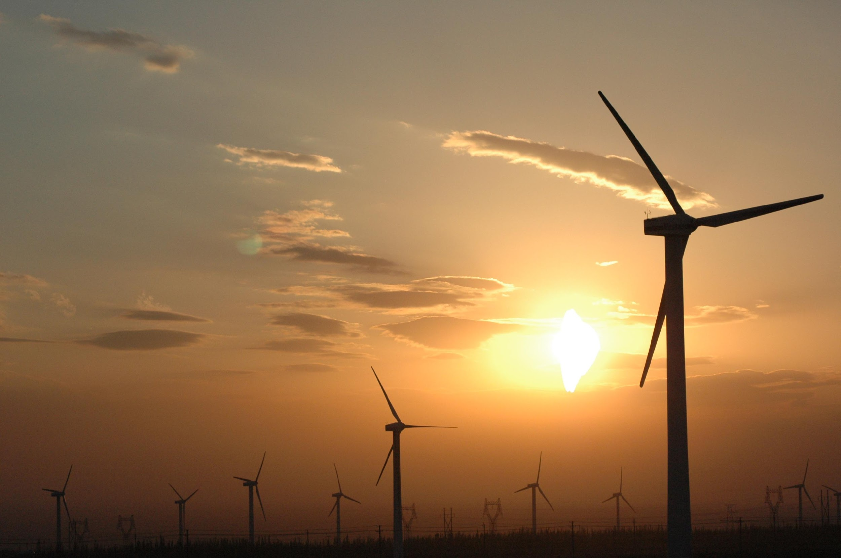
OBJECTIVES
MAIN OBJECTIVE
To conduct a comprehensive data-driven analysis aimed at identifying and recommending optimal locations for wind farms in Kenya, with a focus on the strategic optimization of wind farm placement.
SECONDARY OBJECTIVE
Analyze regional wind data to determine optimal locations for wind farms, focusing on the annual energy that can be produced by industrial sized turbines: Siemens SWT 3.5 - 120t and Vesta v52 850Kw
Analyze historical wind data to understand if there are potential wind related issues i.e gusts that can lead to significant reliability of wind energy produced

Slide 7
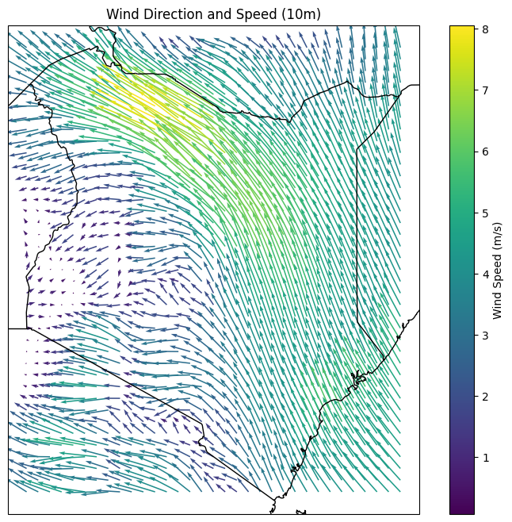
DATA UNDERSTANDING
Our project dataset is from ERA5 website.
Data collected from 2013 to the present.
It contains the following characteristics.
Kenya's grid squares range from 33.9° to 41.9° longitudinally and -4.5° to 5.0° latitudinally, with 1287 squares at 0.25° intervals.
Each square maintains a 0.25° resolution, equivalent to about 25 kilometers.
Time Points: Recorded at 0000 hrs and 1200hrs.
Wind speed from 10m and 100m above the surface.

Slide 8
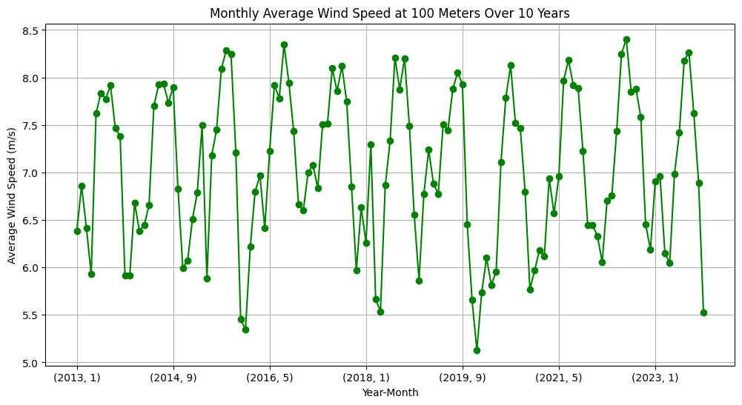
Time series line plot
The moving average wind speeds show constant fluctuations throughout the years.

Slide 9
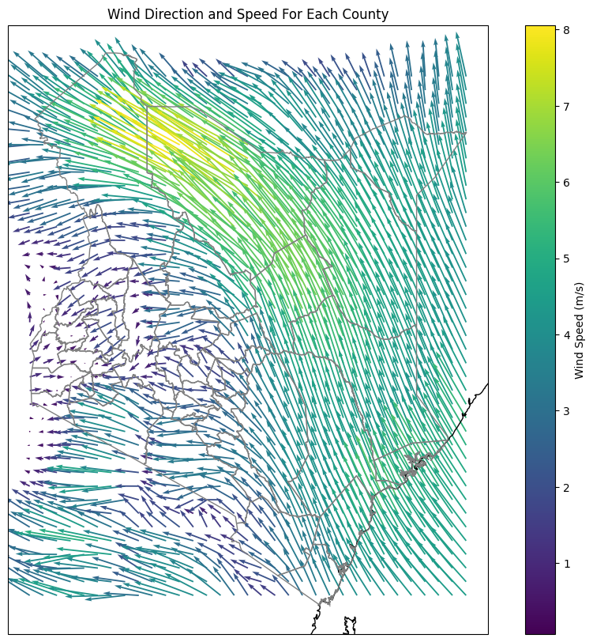
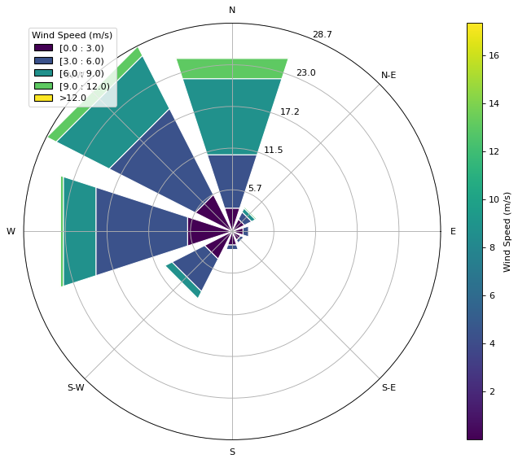
Kenya’s Wind Direction and Strength using Quiver Plot and Wind Rose

Slide 10
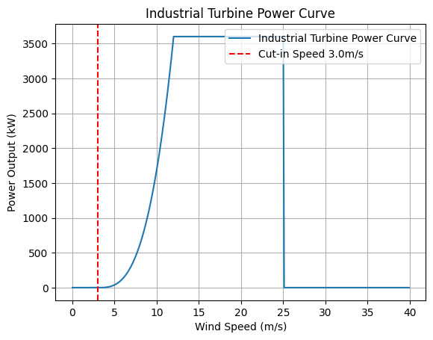
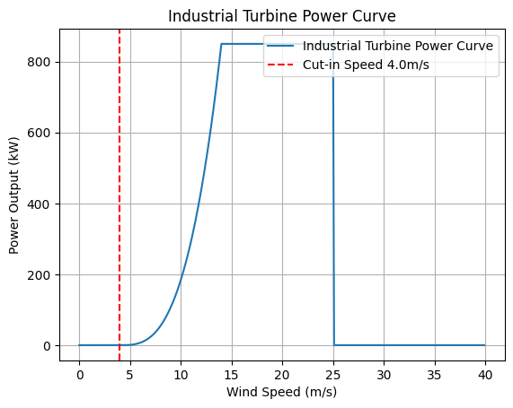
INDUSTRIAL POWER PRODUCTION RATE
Siemens SWT-3.6-120 Wind Turbine
Vestas V52 Wind Turbine

Slide 11
COST BENEFIT ANALYSIS
The former president noted that Kenya loses over Ksh. 2 billion daily. This is enough to buy at least 5 powerful wind turbines (Siemens 3.6 - 120T) per day.
Our current production capacity is 2819 MW. A 1000 of these turbines can produce the same power operating at 75% efficiency.
The 1000 Turbines would cost the taxpayers about Ksh. 361 Billion. The cost of SGR was Ksh 523. 05 billion which would be more than enough to double our output inclusive of installation costs.
These Turbines also have a roughly 10-12 years to break even of their 25-year Lifespan.

Slide 12
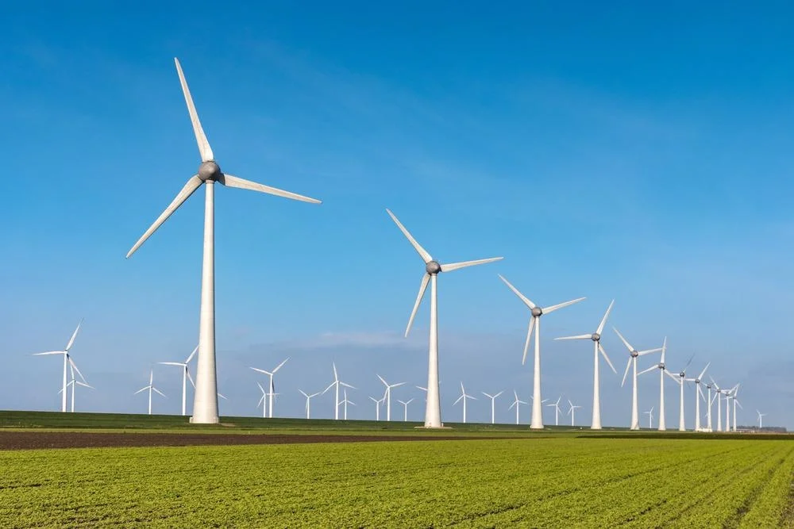
MODELLING
XGBoost model was used to forecast the wind speeds for the years to come , this can help predict how much energy output can be harnessed per county.

Slide 13
CONCLUSIONS
Most of the counties in Western, southern and central kenya are not viable for industrial wind energy production.
Counties with reasonably high wind speeds are: Marsabit, Turkana, Wajir, Isiolo, Garissa and Offshore (most of the Northern and northern Eastern Kenyan counties).
Notably, these areas have lower population density and low land acquisition rates making them suitable for locating wind mills
Offshore is untapped high wind energy resource that can be considered to supplement power energy onshore
Wind gusts in Kenya do not pose any concerns for the location of our wind farms.
Although expensive, the Siemens 3.6 -120 Turbine is the best possible turbine for power production in the country.
Promising Counties for Supplemental Power: Wajir, Garissa, and Isiolo show high weekly power outputs (over 10 MWh) and can be considered for supplemental power needs.

Slide 14


RECOMMENDATIONS
Offshore wind farms
The Kenyan coastline (offshore) has shown strong winds constant wind speeds averaging over 3.5m/s throughout the year - This would make an ideal wind farm location.
Marsabit/Turkana Region
These regions have high average wind speeds and low population density as well as low land costs. These cumulative factors make for ideal site location for long term use
Isiolo and Wajir have reasonable wind speeds but would take longer time to recoup investment
Siemens SWT-3.6-120 Turbine is relatively the best turbine choice for kenyan energy production needs
Has low cut-in-speed (3.0m/s) and high energy output making them more suitable for more places

Slide 15
NEXT STEPS
This project focused on the 100_wind component (wind at 100m above the surface) which is only suitable for industrial wind power generation.
The project can be expanded to use the 10_meter component (wind at 10 m above the surface) to evaluate the possibility of individual power producers to supplement their energy needs
Similar analysis can be done to evaluate the viability of solar farms in those areas to supplement power to the grid for the same area.

Slide 16
THANK YOU

